Slide 1

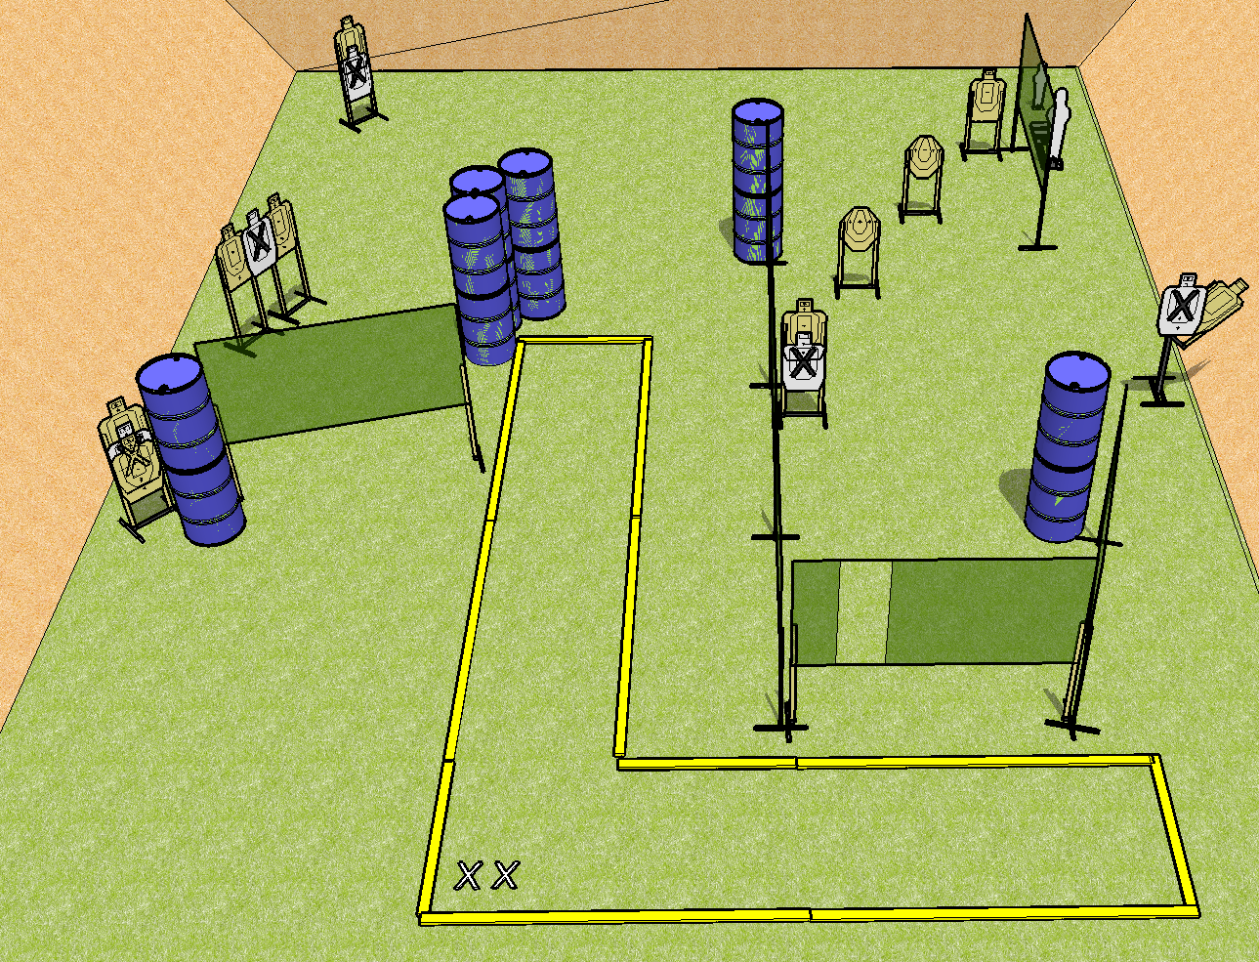
 | Dothan Practical Shooters – USPSA Match Position No Shoot Course Designer : Cory Hobbs Bay: B3
Round Count 22 rounds 10 USPSA 1 pepper popper, 1 mini popper
Equipment List 10 wall feet 15 targets (11 + 4NS)

Slide 2
Position No Shoot
Written Stage Briefing
Scoring: Comstock Rounds: 22
Targets: 10 USPSA, 2 steel
Handgun start position: feet on X’s, wrists below belt. Handgun is loaded and holstered.
PCC start position: feet on X’s, stock on belt. Loaded carbine is held with both hands, safety on.
Stage Procedure: On the audible start signal, engage targets as they become available from within the shooting area.

